Slide 1
MKU
School of Medicine
MBMP 1323 : Cardiovascular Physiology II
Topic: Special Circulation
By J. Alfred, BSc, MSc, MA, PhD cont.
Email: alfredjuma2015@yahoo.com

Slide 2
CORONARY CIRCULATION
Provides blood flow to the heart
Heart mmucles consumes as much O2 as does equal mass of Skeletal Muscles during vigorous Exercise
Heart tissue extracts max amount of O2 during rest
Limited anaerobic glycolysis in the heart,

Slide 3
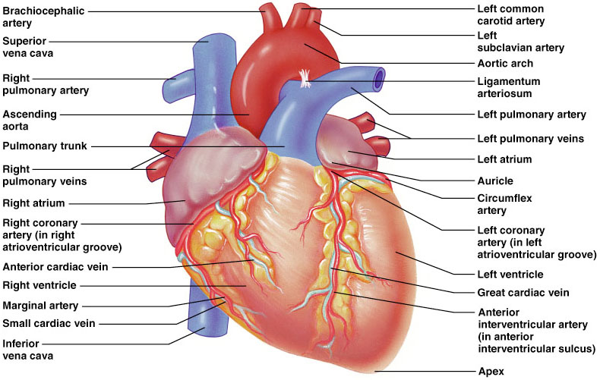

Slide 4
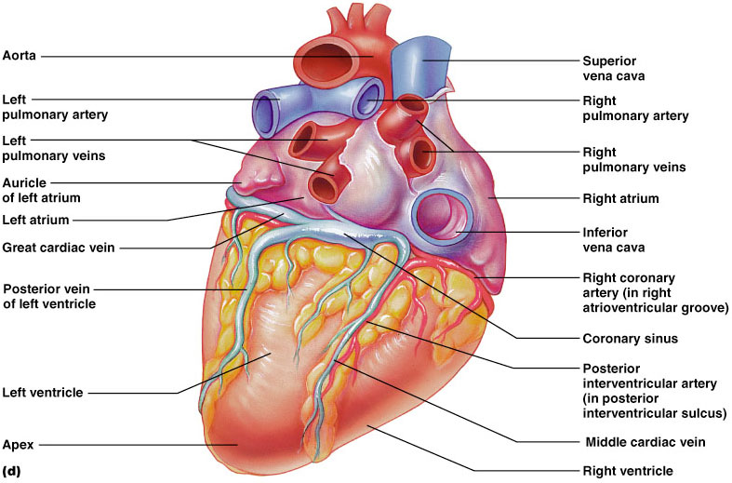

Slide 5
CORONARY CIRCULATION
Perfusion of cardiac muscle from epicardium – endocardium
Cardiac systole
CBF is 10-30% of that during Cardiac diastole
Systolic compression on Right Ventricle is minimum

Slide 6
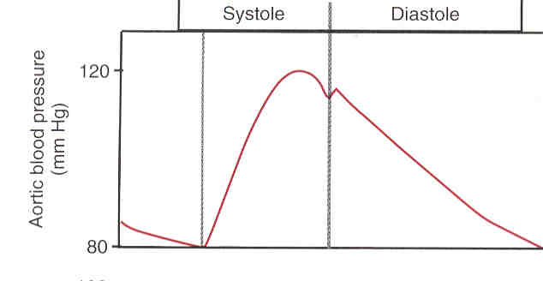

Slide 7
Coronary Vascular Resistance
75 % of CVR occurs in vessels with small diameters-arteries and arterioles)

Slide 8
Mechanisms for Controlling Blood Flow
Local Control:
Autoregulation
e.g., increase or decrease arterial pressure
Active hyperemia
Blood Floor to an organ is proportional to its metabolic activities
Reactive hyperemia
an increase in BF in response to a previous reduction in BF to certain organ

Slide 9
Hypothesis explains the local control of Blood Floor
Myogenic hypothesis
explains autoregulation: vascular smooth m. stretching constriction resistance
Metabolic hypothesis
The O2 delivery to the tissue can be matched with the O2 consumption by changing the Resistance

Slide 10
CORONARY CIRCULATION
Factors affecting CBF:
Chemical factors:
cardiac metabolism Adenosine
NO
H
CO2
O2

Slide 11
CORONARY CIRCULATION
Sympathetic innervation
Constrictor mechanism is important in equalizing BF thru the layers than decreasing BF
α1 (in CA and large arterioles) makes constriction
β2 (in small arterioles) makes vasodilation
β1 activation heart rate

Slide 12
CORONARY CIRCULATION
Sympathetic innervation (cont)
Partial vasoconstriction of CA limits the retrograde BF during ventricular systole
Prevents part of decreased flow in deep layers
coronary vascular resistance (CVR)

Slide 13
Cerebral circulation

Slide 14
LECTURE OBJECTIVES
Cerebral circulation
Circle of Willis
Regulation of Cerebral Blood Flow
Factors affecting cerebral blood flow
Role of carbon dioxide concentration, hydrogen ion concentration, and oxygen concentration in the auto regulation of cerebral circulation

Slide 15
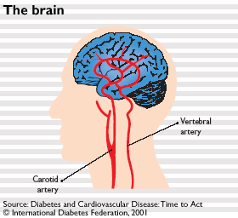
CEREBRAL CIRCULATION
The brain receives its blood supply from four main arteries: the two internal carotid arteries and the two vertebral arteries. The clinical consequences of vascular disease in the cerebral circulation is depend upon which vessels or combinations of vessels are involved.

Slide 16
CEREBRAL CIRCULATION
The Circle of Willis is a grouping of arteries near the base of the brain which is called the Arterial Circle of Willis.
It is named after an English physician named Thomas Willis, who discovered it and then published his findings in his 1664, a seminal peace on the inner workings of the brain entitled, Cerebri anatomi (from the Latin for “Anatomy of the Brain”).

Slide 17
CEREBRAL CIRCULATION
The vertebral arteries unite to form Basilar artery
The basilar artery and the carotids form the circle of Willis
The circle of Willis is origin of six large vessels supplying the cerebral cortex
Substances injected into one carotid artery distributed almost completely to the cerebral hemisphere on that side. Normally no crossing over occurs probably because the pressure is equal on both sides

Slide 18
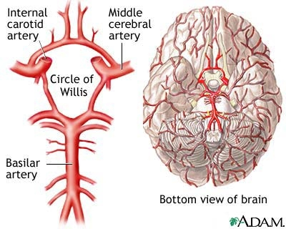
CEREBRAL CIRCULATION

Slide 19
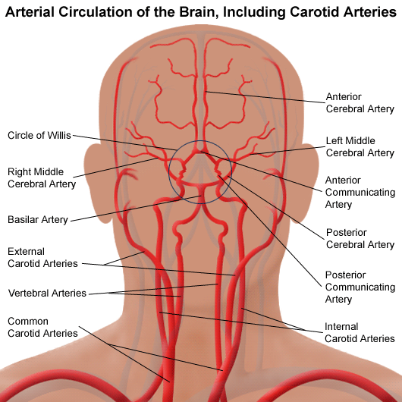
CEREBRAL CIRCULATION

Slide 20
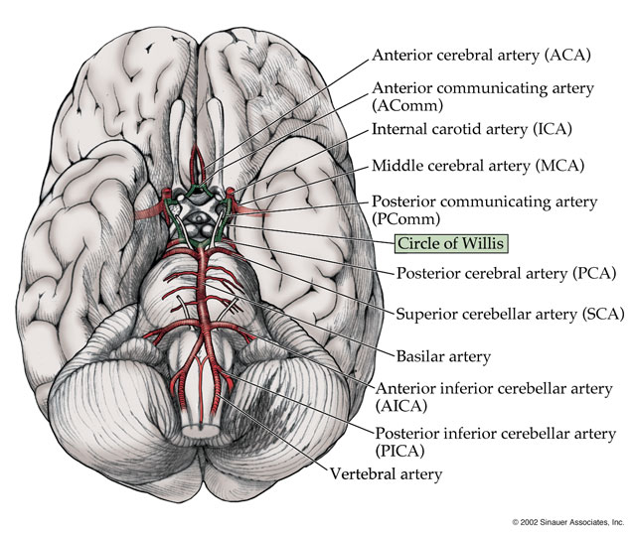
CEREBRAL CIRCULATION

Slide 21
CEREBRAL BLOOD FLOW
Normal Rate of Cerebral Blood Flow
Normal blood flow through the brain of the adult person averages 50 to 65 milliliters per 100 grams of brain tissue per minute.
For the entire brain, this amounts to 750 to 900 ml/min, or 15 per cent of the resting cardiac output.

Slide 22
REGULATION OF CEREBRAL
BLOOD FLOW
Regulation of Cerebral Blood Flow
Cerebral blood flow is highly related to metabolism of the tissue. Three metabolic factors have potent effects in controlling the cerebral blood flow.
cerebral blood flow:
(1) Carbon dioxide concentration,
(2) Hydrogen ion concentration,
(3) Oxygen concentration.

Slide 23
REGULATION OF CEREBRAL
BLOOD FLOW
Increase Cerebral Blood Flow in Response to Excess Carbon Dioxide or Excess Hydrogen Ion Concentration.
An increase in carbon dioxide concentration in the arterial blood perfusing the brain greatly
70 % increase in arterial PCO2 approximately doubles the cerebral blood flow.

Slide 24
REGULATION OF CEREBRAL
BLOOD FLOW
Carbon dioxide is increase cerebral blood flow by combining first with water in the body fluids to form carbonic acid, with subsequent dissociation of this acid to form hydrogen ions.
The hydrogen ions cause vasodilation of the cerebral vessels. The dilation being almost directly proportional to the increase in hydrogen ion concentration up to a blood flow limit of about twice normal.
Any other substance that increases the acidity of the brain tissue, and therefore increases hydrogen ion concentration, will likewise increase cerebral blood flow.
Such substances include lactic acid, pyruvic acid, and any other acidic material formed during the course of tissue metabolism.

Slide 25
REGULATION OF CEREBRAL
BLOOD FLOW
Importance of Cerebral Blood Flow Control by Carbon Dioxide and Hydrogen Ions.
Increased hydrogen ion concentration greatly depresses neuronal activity. Therefore, it is fortunate that an increase in hydrogen ion concentration also causes an increase in blood flow, which in turn carries hydrogen ions, carbon dioxide, and other acid forming substances away from the brain tissues.
Loss of carbon dioxide removes carbonic acid from the tissues; this, along with removal of other acids, reduces the hydrogen ion concentration back toward normal. Thus, this mechanism helps maintain a constant hydrogen ion concentration in the cerebral fluids and thereby helps to maintain a normal, constant level of neuronal activity

Slide 26
REGULATION OF CEREBRAL
BLOOD FLOW
Oxygen Deficiency as a Regulator of Cerebral Blood Flow. Except during periods of intense Brain activity:
The e rate of utilization of oxygen by the brain tissue remains within narrow limits—almost exactly 3.5 (± 0.2) ml of oxygen per 100 grams of brain tissue per minute.
If blood flow to the brain insufficient to supply this needed amount of oxygen, the oxygen deficiency mechanism causing vasodilation, returning the brain blood flow and transport of oxygen to the cerebral tissues to near normal.

Slide 27
REGULATION OF CEREBRAL
BLOOD FLOW
Decrease in cerebral tissue PO2 below about 30 mm Hg (normal value is 35 to 40 mm Hg) immediately begins to increase cerebral blood flow.
This is fortuitous because brain function becomes deranged at not much lower values of PO2, especially so at PO2 levels below 20 mm Hg. Thus, the oxygen mechanism for local regulation of cerebral blood flow is a very important protective response against diminished cerebral neuronal activity and, therefore, against derangement of mental capability.

Slide 28
REGULATION OF CEREBRAL
BLOOD FLOW
Autoregulation of Cerebral Blood Flow When the Arterial Pressure Changes.
Cerebral blood flow is “autoregulated” extremely well between arterial pressure limits of 60 and 140 mm Hg.
Mean arterial pressure can be decreased acutely to as low as 60 mm Hg or increased to as high as 140 mm Hg without significant change in cerebral blood flow. Hypertension, auto-regulation of cerebral blood flow occurs even when the mean arterial pressure rises to as high as 160 to 180 mmHg. If arterial pressure falls below 60 mmHg, cerebral blood flow become severely decreased.

Slide 29
REGULATION OF CEREBRAL
BLOOD FLOW
Role of the Sympathetic Nervous System in Controlling Cerebral Blood Flow. The cerebral circulatory system has strong sympathetic innervation that passes upward from the superior cervical sympathetic ganglia in the neck and then into the brain along with the cerebral arteries.

Slide 30
REGULATION OF CEREBRAL
BLOOD FLOW
Role of the Sympathetic Nervous System in Controlling Cerebral Blood Flow.
This innervation supplies both the large brain arteries and the arteries that penetrate into the substance of the brain. However, transection of the sympathetic nerves or mild to moderate stimulation of them usually causes very little change in cerebral blood flow because the blood flow auto-regulation mechanism can override the nervous effects.

Slide 31
REGULATION OF CEREBRAL
BLOOD FLOW
The sympathetic nervous system normally constricts the large- and intermediate-sized brain arteries enough to prevent the high pressure from reaching the smaller brain blood vessels. This is important in preventing
vascular hemorrhages into the brain—that is,
for preventing the occurrence of “cerebral stroke.”

Slide 32
CEREBRAL
BLOOD FLOW
The arteries and arterioles supply blood to the brain are highly specialized, include both vascular smooth muscle and endothelial cells that are unlike vascular cells from the peripheral circulation or other vascular beds.
The vascular smooth muscle is highly responsive to changes in pressure, a process called myogenic activity, that contributes to auto-regulation of cerebral blood flow. The endothelial cells in the brain circulation are also highly specialized and provide a barrier to fluid movement called the blood-brain barrier. When these normal cell processes fail or altered such as in hypertension

Slide 33
CEREBRAL CIRCULATION
Fainting: Temporary loss of consciousness, weakness of muscles, and inability to stand up, caused by sudden loss of blood flow to the brain.
Fainting is a relatively common symptom caused by a various factors relating to changes in blood pressure.
The American Heart Association reports that fainting is responsible for 3% of all visits to emergency rooms and 6% of all admissions to hospitals.

Slide 34
CEREBRAL CIRCULATION
Stroke: Stroke occurs when the blood supply to a part of the brain is blocked resulting in the death of an area within the brain.
If a large vessel is blocked the outcome may be rapidly fatal or may lead to very severe disability.
If smaller blood vessels are blocked the outcome is less severe and recovery may be good. The most common types of disability are the loss of functions of one side of the body and speech problems.

Slide 35
CEREBRAL CIRCULATION
Principal types of stroke:
Thrombotic: Stroke due to the blockage of an artery leading to or in the brain by a blood clot.
Haemorrhagic: Stroke due to bleeding from a ruptured blood vessel, usually a consequence of hypertension.
Embolic: Stroke due to the formation of a blood clot in a vessel away from the brain. The clot is carried in the bloodstream until it lodges in an artery leading to or in the brain.
The thrombotic and haemorrhagic forms are common,

Slide 36
CEREBRAL CIRCULATION
Transient ischaemic attack: When blood supply to a part of the brain is temporarily interrupted without producing permanent damage.
Recovery may occurs within 24 hours.
Usually result from small blood clots or clumps from plaques of atheroma which get carried into the blood circulation producing transient blockages.
Occasionally these clots may get carried from the heart or arteries leading to the brain (e.g. carotid arteries), rather than from within the cerebral circulation itself.

Slide 37
CEREBRAL CIRCULATION
Dementia: This may result from repeated episodes of small strokes which produce progressive damage to the brain over a period of time.
The main clinical feature of dementia is a gradual loss of memory and intellectual capacity.
Loss of motor function in the limbs and incontinence can also occur.

Slide 38
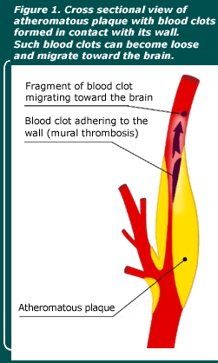
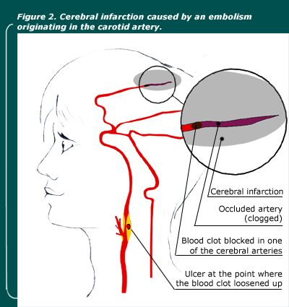
CEREBRAL CIRCULATION

Slide 39
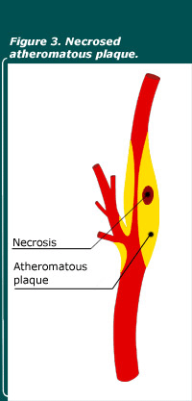
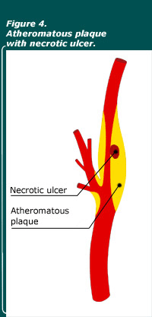
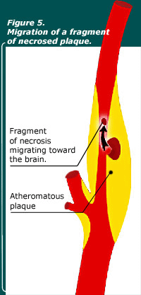
CEREBRAL CIRCULATION

Slide 40
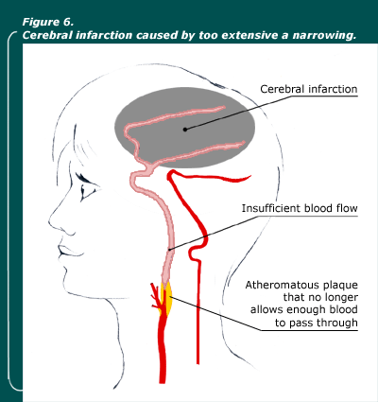
CEREBRAL CIRCULATION

Slide 41
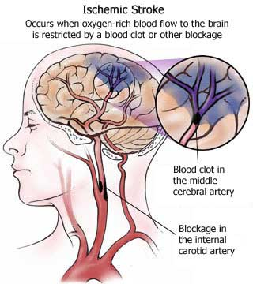
CEREBRAL CIRCULATION

Slide 42
Factors disturb the autoregulation
A variety of noxious stimuli such as hypoxia due to occlusive cerebrovascular disease, trauma from head injury or surgery, or brain compression from tumors, hematomas or cerebral edema, results in the loss of normal cerebral blood flow (CBF) autoregulation.

Slide 43
Lecture summary
The Circle of Willis is a vital formation of arteries at the base of the brain
Brain receives its blood supply from four main arteries, the two internal carotid arteries and the two vertebral arteries.
Normal blood flow through the brain of the adult person averages 50 to 65 milliliters per 100 grams of brain tissue per minute.
carbon dioxide concentration, hydrogen ion concentration, and oxygen concentration have potent effects in controlling the cerebral circulation.
Noxious stimuli such as hypoxia due to occlusive cerebrovascular disease, trauma from head injury or brain compression from tumors, hematomas or cerebral edema, results in the loss of normal cerebral blood flow / auto regulation.

Slide 44
Fetal Circulation

Slide 45
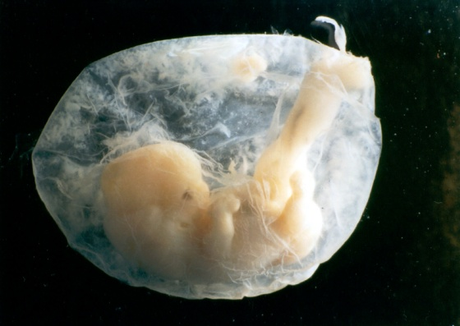
Fetal Cardiovascular system is designed:
1-To serve prenatal needs.
2-To permit modifications at birth, which establish the neonatal circulation.

Slide 46
Good respiration in the newborn infant is dependent upon normal circulatory changes at birth.

Slide 47
Three structures are very important in the transitional circulation:
1- Ductus venosus.
2- Ductus arteriosus.
3- Foramen ovale.

Slide 48
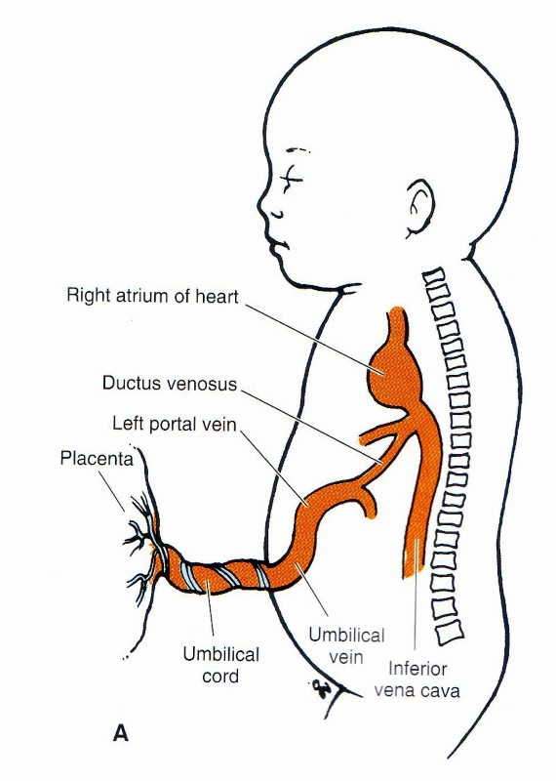
Blood reaches &
leaves the fetus
through the umbilical cord.
The umbilical cord
Contains two arteries and one
vein.

Slide 49
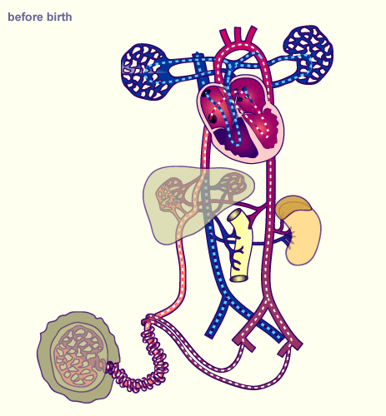
Highly oxygenated blood passes from the placenta through the umbilical vein.
Half of this blood reaches the IVC through the ductus venosus.
Ductus venosus

Slide 50
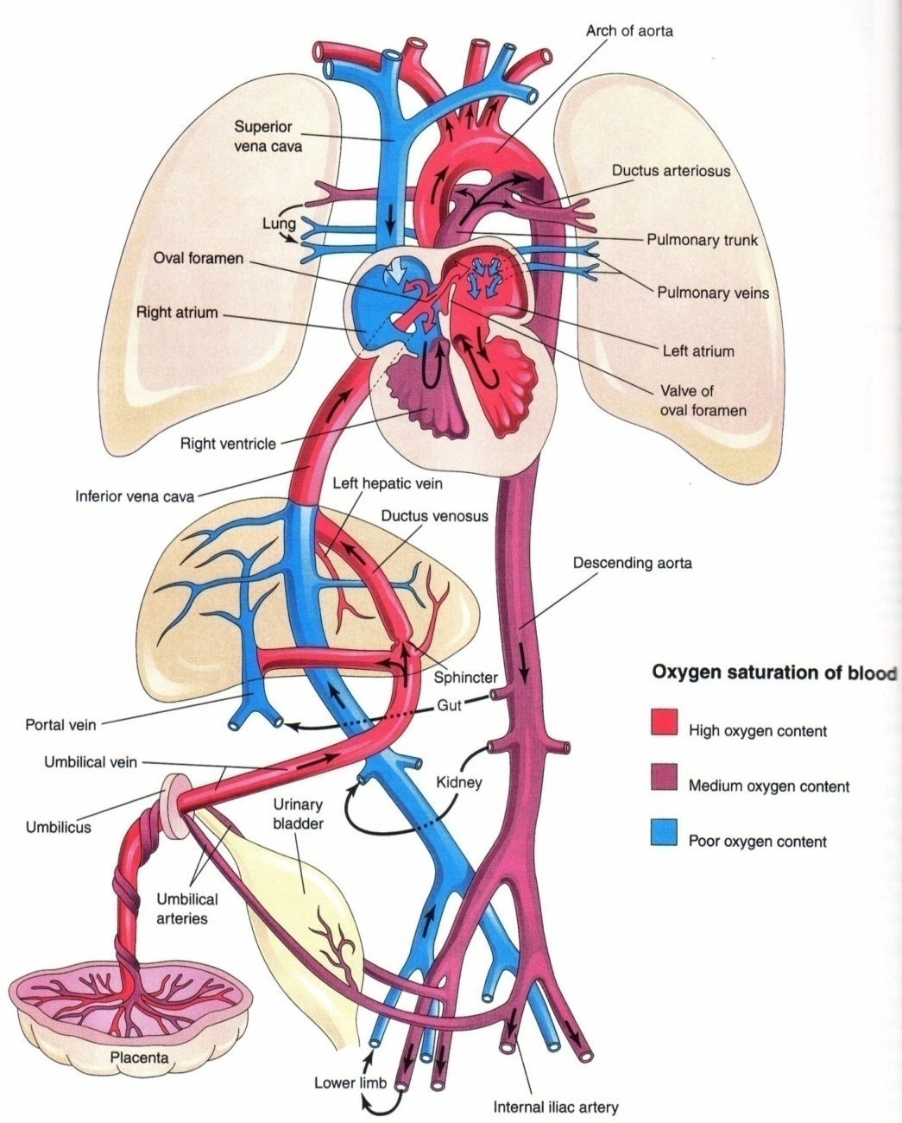
The other Half passes to liver sinusoids then to the IVC.
Blood of the IVC reaches the right atrium, then left atrium through the Foramen Ovale.
Then to the left ventricle to the ascending aorta, and the aortic arch to supply head & neck brain, cardiac muscle and upper limbs.

Slide 51
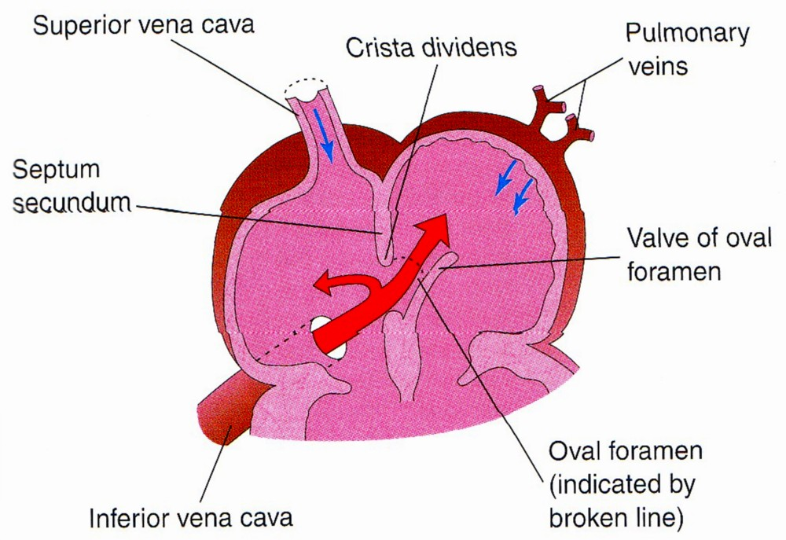

Slide 52
Small amount of highly oxygenated blood in right atrium mixes with venous blood of the SVC passes to right ventricle .
Then to the pulmonary artery then to Ductus Arteriosus (between the Pulmonary trunk & Proximal part of the descending aorta), to the fetal body.
Then back to placenta via the umbilical arteries.
Ductus arteriosus

Slide 53
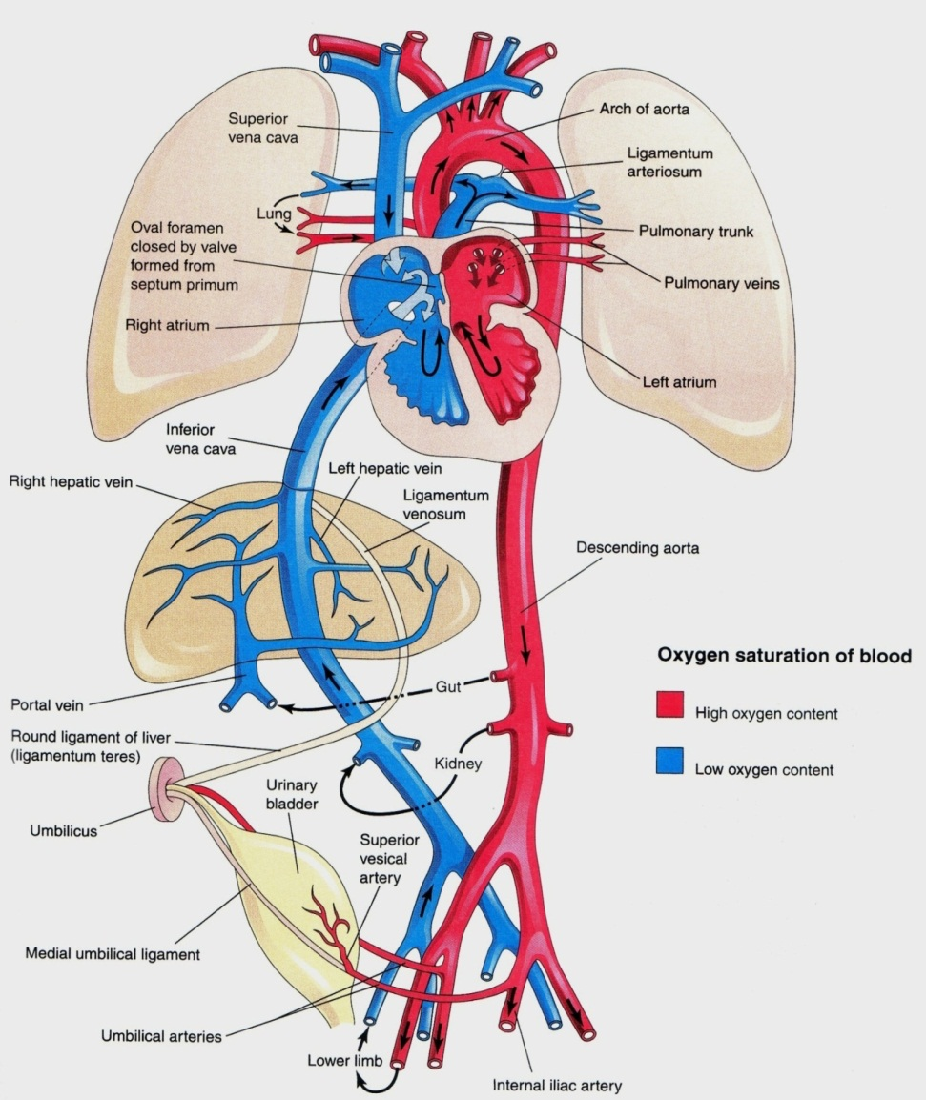
After Ligation of the umbilical cord
Sudden fall of blood pressure in the IVC and the right Atrium.
The valve of the ductus venosus constricts.
  After Aeration of the lungs at birth:
1- Marked increase in the pulmonary blood flow.
2- Dramatic fall in pulmonary vascular resistance.
3- Thinning in the wall of the pulmonary arteries.

Slide 54
Changes After Birth
1- Closure of foramen ovale:
a. Physiological closure
b. Anatomical closure.
2- Constriction of ductus arteriosus:
By the end of the first 24 hours 20% of the lumen of the ductus is closed.
By the end of 48 hours 82% is closed.
By 96 hours 100% of the duct is closed

Slide 55
Bradykinin:
It is a substance released from fetal lungs during their initial inflation.
This substance has a contractile effect on smooth muscles of the ductus arteriosus.
The action of this substance appears to be dependant on the high Oxygen saturation of the aortic blood.

Slide 56
When oxygen tension reaches 50 mmHg in the ductus arteriosus it causes constriction of its smooth muscles.
During intrauterine fetal life the patency of ductus arteriosus (before birth) is controlled by the low contents of oxygen in the blood passing through it.
So hypoxia and other ill-defined factors keep the ductus arteriosus patent.

Slide 57
Adult derivatives of fetal vascular structures
1- Umbilical vein------Ligamentum teres.
2- Umbilical arteries—medial umbilical ligaments.
3- Ductus venosus-----Ligamentum venosum.
4- Ductus arteriosus---Ligamentum arteriosum
5- Foramen ovale----fossa ovalis.

Slide 58
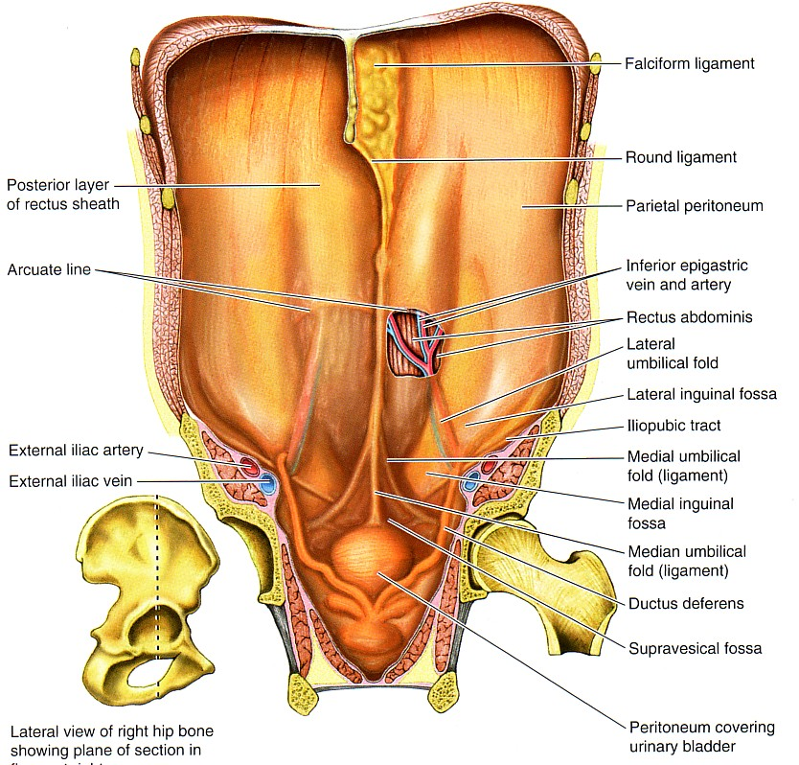
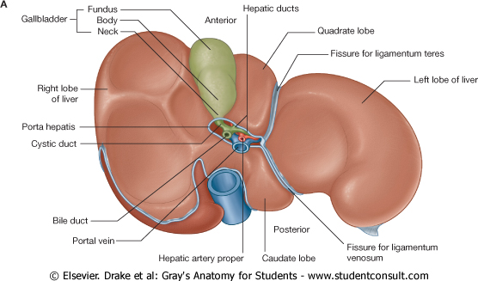
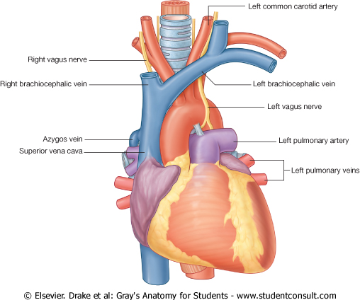
Ligamentum arteriosum

Slide 59
Thank You

